Slide 1
HRS Upgrade Training
The following slides were presented at the May 2021 EXCIT meeting for the Research Community as training for the upcoming HRS upgrade.

Slide 2
GRIT Updates
HRS v10.0 Upgrade – Important Dates
HRS sites unavailable starting Friday, May 21st at 6:00 PM EST through the weekend (May 22nd and May 23rd)
All Huron users should complete their work by this time
Upgraded HRS sites & Reference Guides available in Help Centers will be available on Monday morning, May 24th at 7:00 AM EST.
Huron Grants S2S – DUNS to UEI Transition
HRS Upgrade Training
Suite-wide updates to all modules
Huron Grants updates

Slide 3
Huron Grants S2S – DUNS to UEI Transition
DUNS numbers have been the unique identifier used for validation and verification of entities for federal grants and contracts
UEI numbers are new identifiers issued by SAM.gov that will replace DUNS numbers
UCF’s HRS 10.0 upgrade will support S2S submissions to agencies using both DUNS and UEI numbers

Slide 4
Huron Grants S2S – DUNS to UEI Transition
Important Dates
May 17, 2021 | Grants.gov will deploy UEI forms | Note: It is up to the Agency how they post application packages. Agencies may post separate application packages for DUNS and UEI for the same opportunity or may only post an application package for the UEI. It’s also up to the agency how they distinguish these – either by the Opening/Closing Date or by Competition ID. Huron SMEs do not expect to see this until closer to October.
May 24, 2021 | UCF HRS 10.0 upgrade that supports UEI
October 1, 2021 | Grants.gov transition to using UEI as primary identifier, however DUNS will still be accepted
April 4, 2022 | Grants.gov complete transition to UEI (DUNS no longer accepted)

Slide 5
HRS Upgrade Training
Suite-wide enhancements
Improved Inbox now called “Dashboard”
Recently Viewed
Pinned
Display improvements
Personalized data display
Breadcrumbs
Streamlined Activity History view
New “Site Search” feature
Huron Grants Updates
Slides will be published to Project Wahoo site https://wahoo.research.ucf.edu

Slide 6
Huron Grants Updates
Notification Updates
Display Improvements
Workspace Improvements
SmartForm Improvements
New FCOI Investigator
Follow-On Proposals
Tags
Ancillary Reviews
Known Issues
Bug Fixes

Slide 7
Research Community Training Resources
May 2021 EXCIT PowerPoint Presentation
Help Center
Reference Guides
FAQs (updated post-go live)
Videos (updated post-go live)
Huron Learning Lab
https://huronsoftware.talentlms.com/
UCF Email to log in
For an account to Huron Learning Lab, please email Beaverton_HLL@huronconsultinggroup.com
Grants Section
Notes:
For users who need more detailed information on using Huron Grants, you can access the Huron Learning Lab
Are there any questions about the training overview?
Now we’ll move on to the Central Office Dashboard

Slide 8
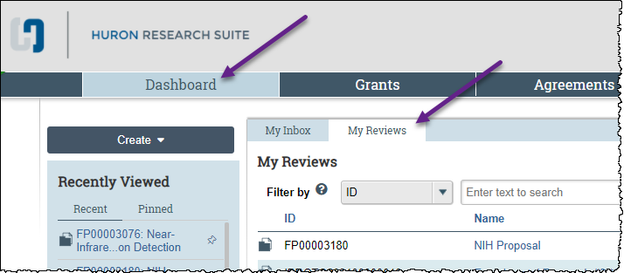
HRS Suite-wide Update - Dashboard
“Inbox” relabeled “Dashboard”
“My Inbox” tab displays the same list
New “My Reviews” tab displays ancillary reviews assigned to you

Slide 9
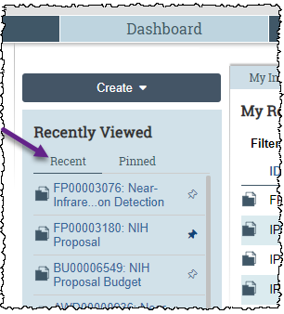
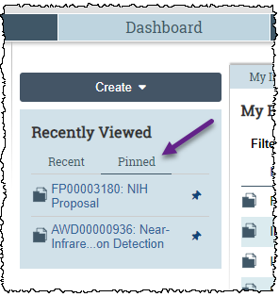
HRS Suite-wide Update - Dashboard
New “Recently Viewed” section (displays last 10 records)
Ability to ‘pin’ most important records for quick access
Notes:
The Recently Viewed Component displays links to items that you have navigated to either on the SmartForm or the Workspace of the project.
You’ll notice that this component has two tabs of Recent and Pinned records.
Recent displays the last ten projects you accessed, allowing you to quickly resume work in progress.
Pinned is when you mark a recently viewed record of importance that you want to maintain quick access to. While the recently viewed will change to the most recent 10 records, pinned will let you mark specific records for fast access until you remove the pin.
Pinned and recently viewed are mutually exclusive lists and will show up to 10 records for each section
To pin a record
Click the pin icon in the recent list to change the color to blue and add it to your pinned section.
Click a blue pinned icon to de-select it and remove it from the pinned list.

Slide 10
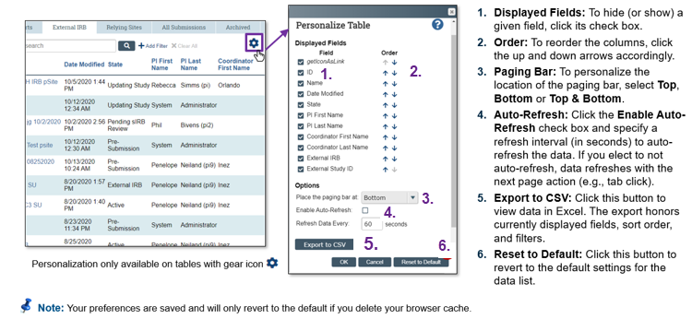
HRS Suite-wide Update – Display improvements
Ability for individuals to personalize data display
Notes:
Personalized data displays allow you to control your views on tables so you display only the information that is important to you.
You can control what fields are displayed, in what order, and other customizable options to maximize your display efficiency.
Like where to place the paging bar
How frequently you want to auto refresh, if at all
The ability to export the table to a CSV file
And if you want to reset the view to the default display
This feature will be available anywhere within the module where data tables appear (dashboards, workspaces, reports etc. wherever the gear is displayed)
Your preferences are saved and will only revert to the default display if you choose to revert to the default or if delete your browser cache.

Slide 11
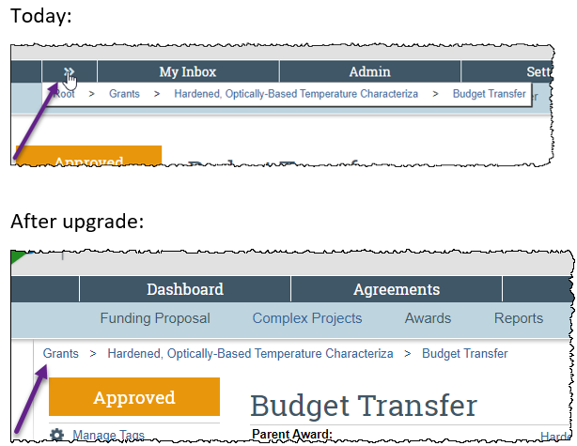
HRS Suite-wide Update – Display improvements
Breadcrumbs displayed on Workspace to improve navigation
Notes:
Another display improvement is the visibility of navigational breadcrumbs on the workspace to allow you to navigate layers of the record faster and view parent record names without having to search for them.

Slide 12
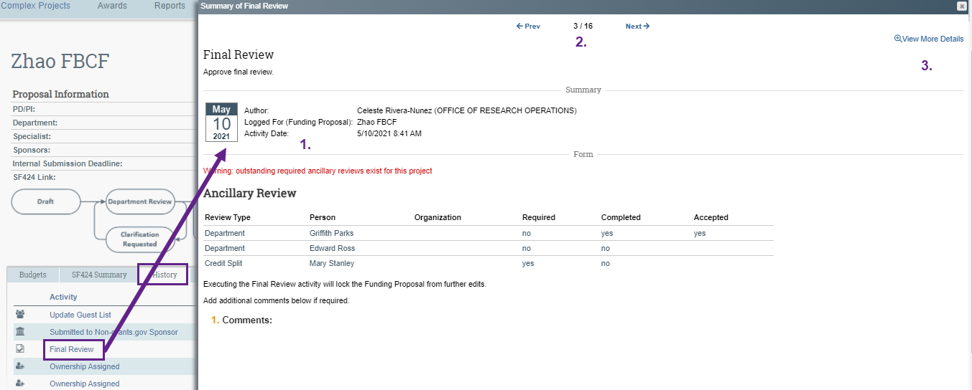
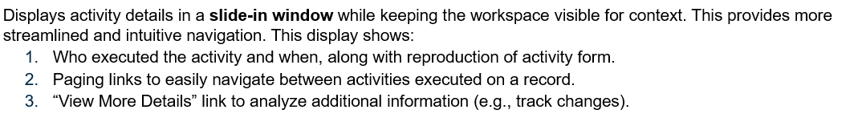
HRS Suite-wide Update – Display improvements
Streamlined Activity History view
Notes:
Another display improvement is within the history tab.
The tab displays the same type of information we see today but in a much more user-friendly format and with greater detail.
The activity details are displayed in a slide-in window that allows you to keep workspace content visible while you review details.
You can also see
Who executed an activity
Paging links to navigate each history entry
And a View More Details link that lets you see additional information (like track changes)

Slide 13
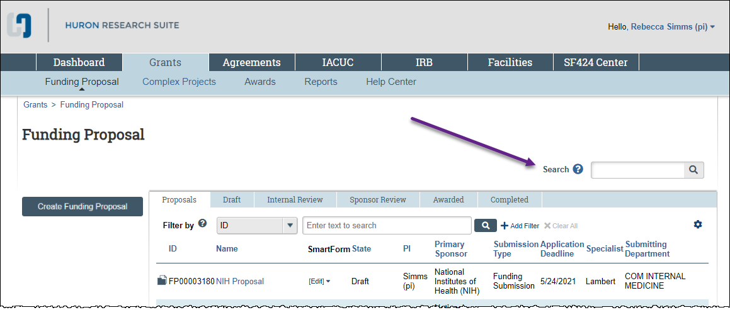
HRS Suite-wide Update – Site Search
Allows keyword searches against records and documents in each module
Notes:
Another new feature for HRS 10.0 is Site Search, located at the top left of the module landing page that will allow you greater ability to search for records within Huron.
This is a cross-suite addition, which means all modules will have this feature. The searching, however, will be limited to items within the module on which you are searching (typing info here will not search agreements or IRB, for example)

Slide 14
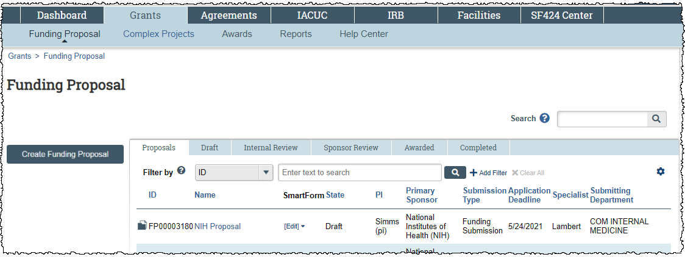
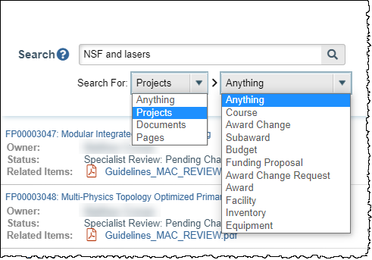
HRS Suite-wide Update – Site Search
Use the “Search For” drop-down lists to narrow your search
Notes:
For Grants, Site Search will allow you to search for values on FPs, Budgets, Awards, Award Mods, Award Mod Requests, and Subawards
Search results will display in a separate pop-up window.
Dropdown filters provide more targeted search results.
Search results include clickable links (e.g., to project workspace).

Slide 15
HRS Suite-wide Update – Site Search
Important Notes for using Site Search
Searches a specific list of fields indexed within each module. This does include document searches (Word, PDF, and Excel formats), but only when the documents have been uploaded using specific activities
Reference Guides contain the list of indexed fields and activities
Site search tool does not currently support partial word searches (e.g. “educ” instead of “education”) or wild card searches using “%” or “*”.
Please review new “Site Search” section in Reference Guides for instructions, tips, and best practices
Notes:
Some important notes about using site search
(read 1-3)
You can review instructions, tips and best practices for site search in the reference guides that will be available May 24th.
(Jen will jump in with a clarifying point on searching by PI)

Slide 16
Grants v10.0 Upgrade Research Community- Notification Updates
Notifications
Email notifications sent when activities are triggered and when states change for Proposal, Awards, Award Mods and Award Mod Requests
Additional notifications are sent for Submit JIT Response and Proposal Ancillary Reviews
Header Changes
To
Link
PI
Title
General reason why notification was sent
Body Changes
Comments (if present)
Supporting Documents (if present)
Notes:
Improvements have also been made to Notification templates to apply uniform standards to format and content
As you know, automatic Email notifications are sent when activities are triggered and when states change for proposals, awards, award mods and award mod requests. Email notifications are also manually sent when you use the “Send Email” feature on a record.
All these email notifications will now be standardized with more helpful information, including updates to the header that contain (read list)
And the body of the notification includes comments and supporting documents (if present)

Slide 17
Grants v10.0 Upgrade Research Community- Notification Updates
New Notifications
Notification will be sent to the assigned specialist when the Submit JIT Activity is executed
A 90 Day reminder will now be sent on deliverables
Notification will be sent to the assigned specialist when Submit Ancillary Review activity executed on proposals, awards and award mods
Notes:
Some new notifications of note that have been added include:
On last, so its not just when one is created, but also when one is submitted (completed).

Slide 18
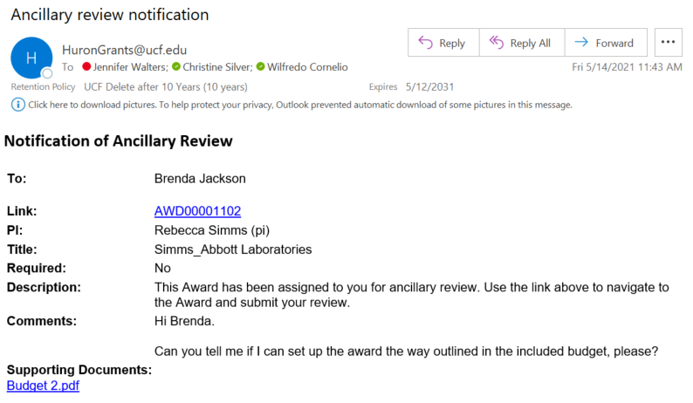
Grants v10.0 Upgrade Research Community- Notification Updates
Notes:
Here’s an example of an automatically generated ancillary review email notification with the applied changes.

Slide 19
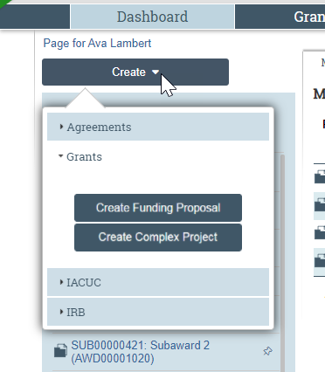
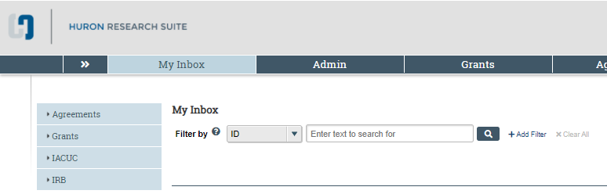
Grants v10.0 Upgrade Research Community- Display Improvements
Create Buttons
After Upgrade
Today
Notes:
To create a funding proposal quickly,
Click create and expand the menu under “Grants”.
Click the Create Funding Proposal button.
Click anywhere off of the create menu to close it

Slide 20
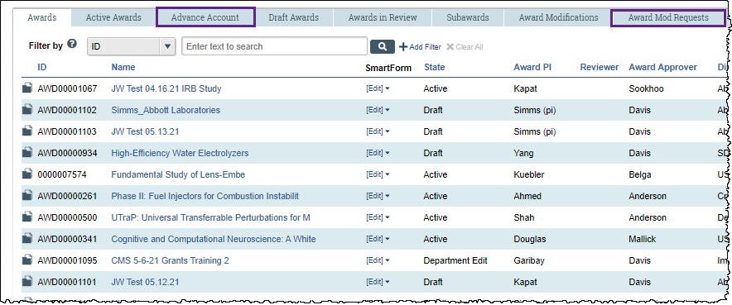
Grants v10.0 Upgrade Research Community- Display Improvements
Two New Award State Tab Views: Advanced Account and Award Mod Requests
Notes:
Awards tabbed views by state now include 2 new tabs: Advanced Account and Award Mod Requests. Clicking either of these will display all awards in the indicated states.

Slide 21
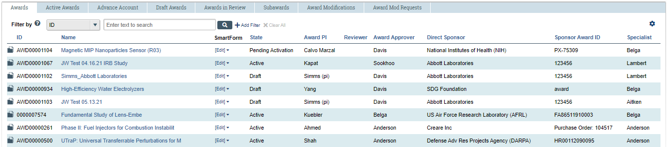
Grants v10.0 Upgrade Research Community- Display Improvements
Additional Columns in the Awards Tab Tables
Notes:
Awards tabbed default tables have also added columns to the displayed information like with proposals to show additional information about the awards, including:
Award PI
Direct Sponsor
Sponsor Award ID
Start Date
End Date
Specialist
Any questions on these Display improvements?
OK, now we’ll move on to Award Workspace changes

Slide 22
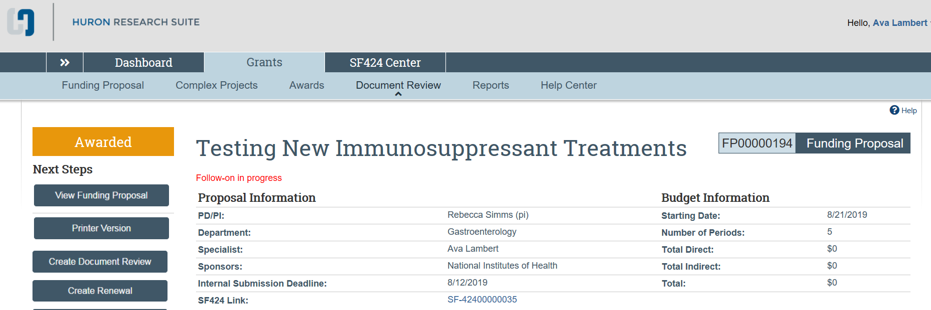
Grants v10.0 Upgrade Research Community- Workspace Improvements
SF 424 Link in Proposal Header
Notes:
Some improvements to workspaces to make you aware of:
On the Proposal workspace, if a proposal will be sent system to system and you have generated an SF424, you will now see a link to the SF424 in the Proposal header. Previously, you had to click the SF424 tab and read into the details to access this link. This streamlined navigation will be a welcome enhancement for system-to-system proposals.

Slide 23
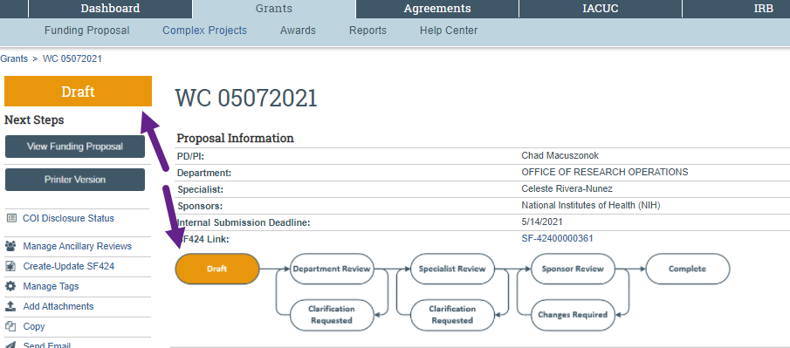
Grants v10.0 Upgrade Research Community- Workspace Improvements
Workflow Diagrams
Proposal Workflow Diagram
Notes:
Another enhancement to workspaces is the workflow diagram.
The current state of the record will be reflected on the diagram by a bubble indicator of where the record is in the workflow and what comes next.
This proposal is in a state of draft and the corresponding workflow diagram bubble shows the same with Department Review to follow.

Slide 24
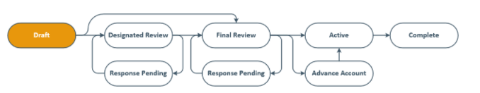
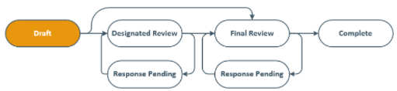
Grants v10.0 Upgrade Research Community- Workspace Improvements
Workflow Diagrams
Award Workflow Diagram
Award Mod Workflow Diagram
Notes:
Awards and Award Mods will also have a workflow diagram showing the workflow steps specific for each record type.

Slide 25
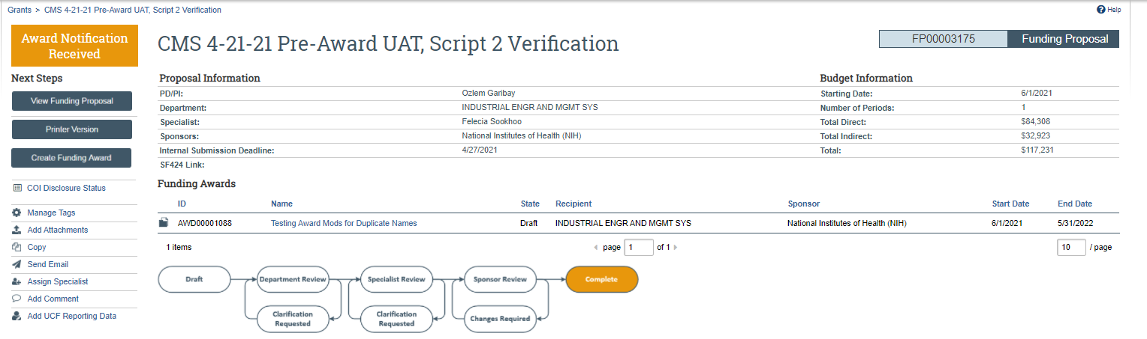
Grants v10.0 Upgrade Research Community- Workspace Improvements
Workflow Diagram will show Complete when state is Award Notification Received
Notes:
On the proposal workflow diagram, one thing to note is the “Complete” bubble - In 10.0, if a proposal is marked as “Award Notification Received” the workflow for the proposal moves to “Complete”. Technically, the workflow for the proposal is complete.

Slide 26
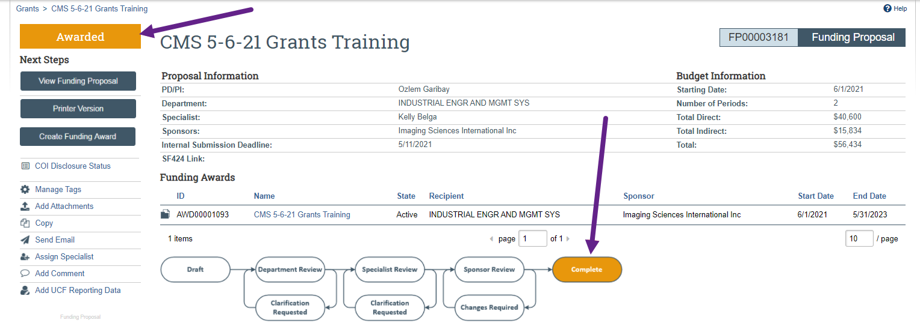
Grants v10.0 Upgrade Research Community- Workspace Improvements
Proposals will no longer transition past the “Awarded” state when the Award is complete
Proposal state will be “Complete” and the Workflow Diagram will show Complete when an award created from the proposal is Active
Notes:
But the proposal state will transition to Awarded once an Award is Activated. The workspace bubble will remain “Complete” as the funding proposal work is still complete in this state.
Also, in terms of a proposal state, proposals will no longer transition past “Awarded” once an award is created. (today, they transition to complete once an award is completed)

Slide 27
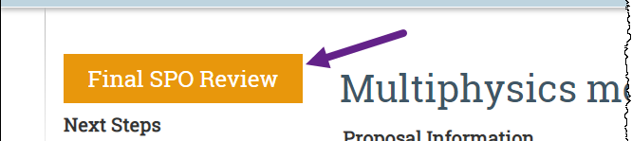
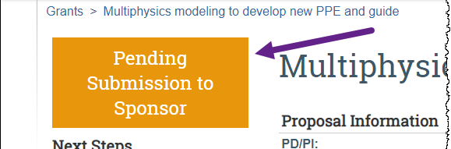
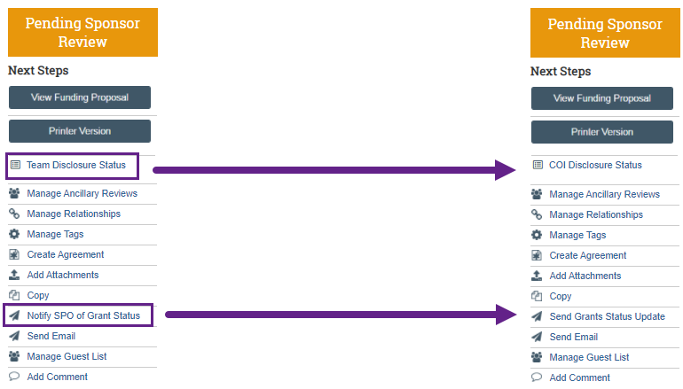
Grants v10.0 Upgrade Research Community- Workspace Improvements
State and Activity Name Changes
Today
After Upgrade
Notes:
Another workspace improvement includes state and activity name changes to more specific titles to be clearer and in alignment with best practices. These include:
Removing/replacing the terms “SPO” and “SPA”, specifically:
Notify SPO of Grant Status -> Send Grants Status Update
Final SPO Review -> Pending Submission to Sponsor
SPO Status Confirmation –> Proposal Status Confirmation (Not Shown Here)
Also, the “Team Disclosure Status” activity name has been changed to “COI Disclosure Status”

Slide 28
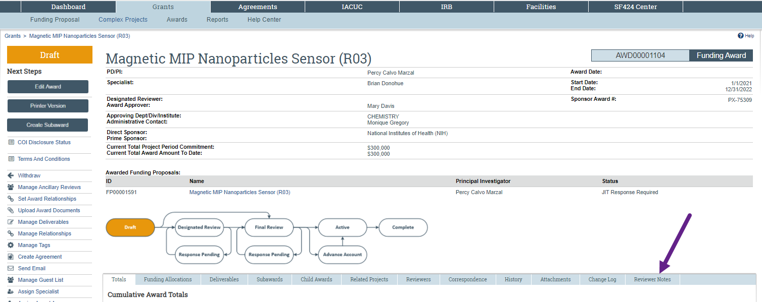
Grants v10.0 Upgrade Research Community- Workspace Improvements
Award/Award Mod Reviewer Notes Tab
Notes:
A Reviewer Notes tab has been added to the Award & Award Mod workspaces to allow you to view any reviewer notes and responses added during the award & award mod review process

Slide 29
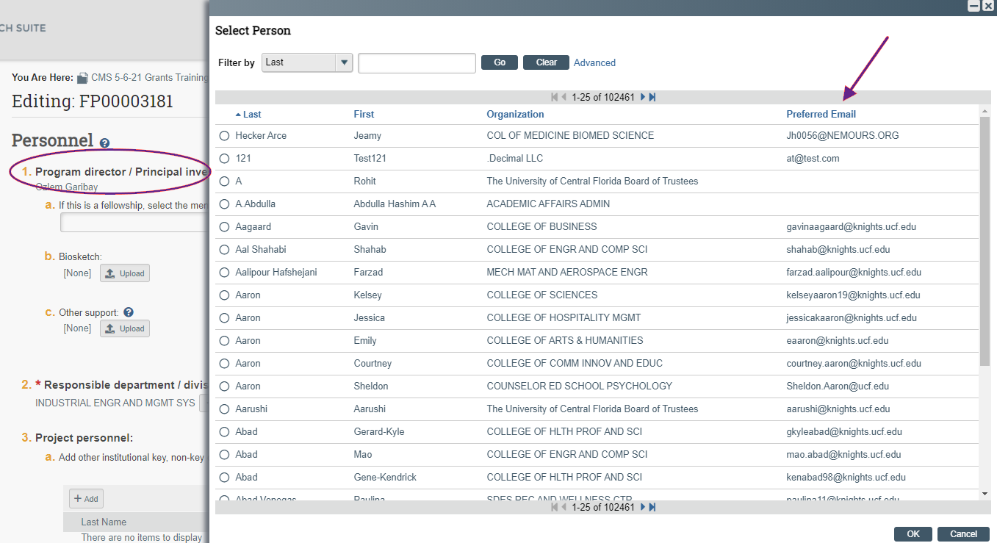
Grants v10.0 Upgrade Research Community- SmartForm Improvements
People Chooser with Preferred Email
Notes:
Some smartform improvements include additions to chooser menus, like the people chooser – When selecting the PI or additional personnel, you can now see the preferred email address along with the first & last name and the organization to which they are assigned.
This change is applied to proposals, awards and award mod smartforms.

Slide 30
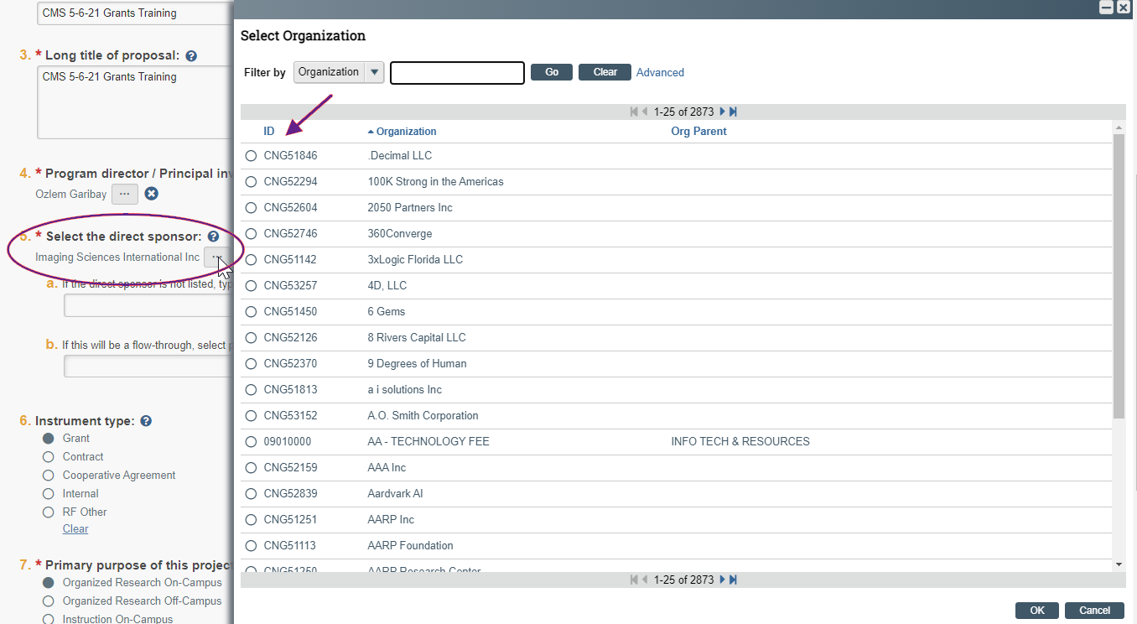
Grants v10.0 Upgrade Research Community- SmartForm Improvements
Organization Chooser with Org Code
Notes:
The Organization Chooser, like choosing the direct sponsor, now displays the organization code along with the organization name.
This change is also applied to proposals, awards and award mod smartforms.

Slide 31
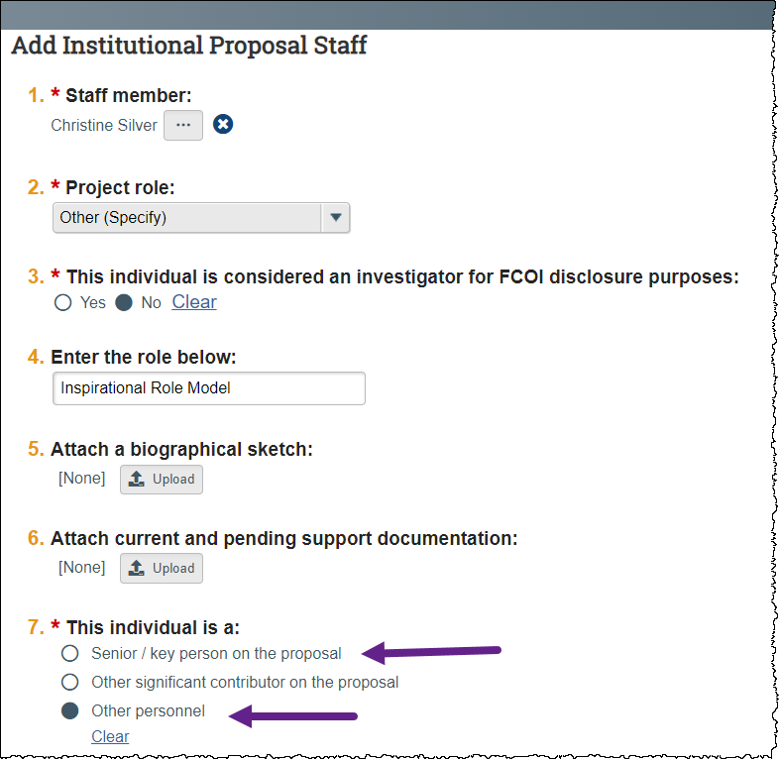
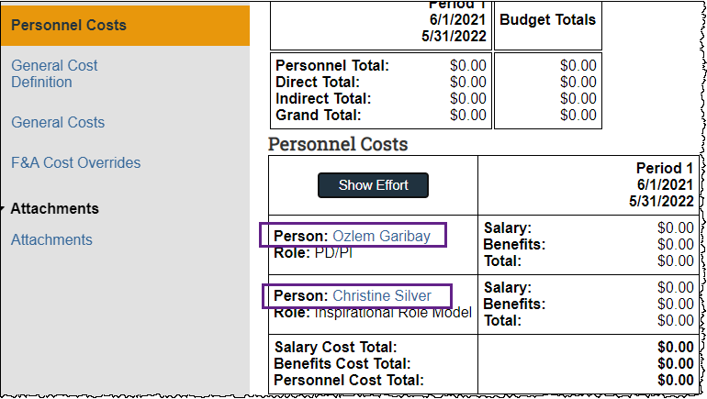
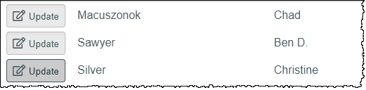
Grants v10.0 Upgrade Research Community- SmartForm Improvements
Proposal Budget SmartForm
Only Senior/Key Personnel and Other Personnel on Proposal will import to Personnel Cost page of Budget SmartForm.
Notes:
A change to note on the Proposal Budget SmartForm is related to the type of personnel defined in question 7. of the “Add Institutional Proposal Staff” on the Proposal SmartForm.
Only added personnel who have either Senior/key person on the proposal or other selected for question 7 will be displayed on the “Personnel Costs” page of the budget SmartForm.

Slide 32
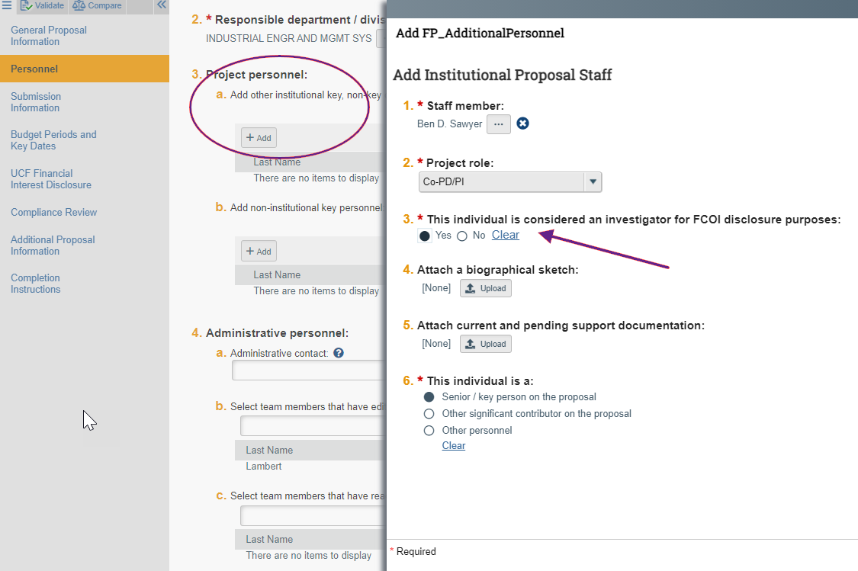
Grants v10.0 Upgrade Research Community- New FCOI Investigator
New Personnel Question when adding other institutional project personnel: #3 This individual is considered an investigator for FCOI disclosure purposes: Y/N
(is #1f. For add non-institutional key personnel)
Notes:
New functionality introduced in our 10.0 upgrade includes the addition of FCOI Investigators. This changes affects proposals, awards and award mods.
On the proposal, when adding project personnel, a new required question is displayed "This individual is considered an investigator for FCOI disclosure purposes:" defaults to yes.
An FCOI Investigator has been determined to be an individual who is responsible for design, conduct or reporting activities for the research outlined in the proposal or award.
The PI for the Proposal is assumed yes, so this question does not need to be answered for the PI, just additional people added to the proposal or award.

Slide 33
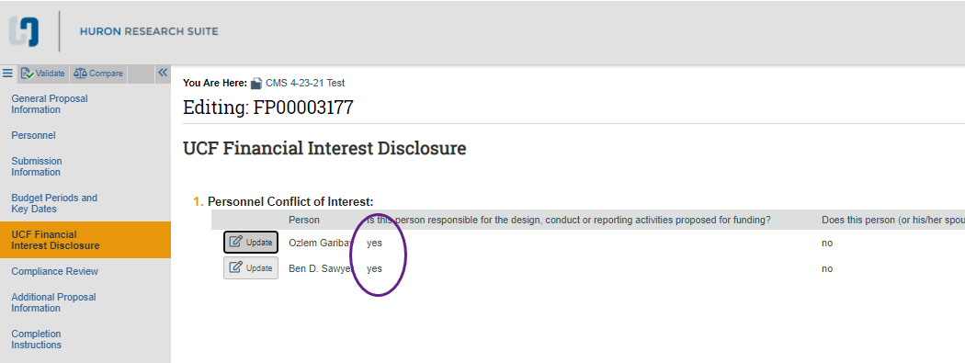
Grants v10.0 Upgrade Research Community- New FCOI Investigator
This should match a “Yes” answer on the UCF Financial Disclosure Page to the question of whether or not the “Person is responsible for the design, conduct or reporting activities proposed for funding?
The process for submitting the certification document will remain the same.
Notes:
You should note that this corresponds to the existing “UCF Financial Interest Disclosure” Proposal SmartForm page that was custom created for UCF as a temporary measure until the HRS COI module is implemented.
While the new question asks about Design, conduct and reporting, the financial interest disclosure questions are still needed on the custom page until COI is live.
You will want to make sure that the answer you provided for the new #3 DCR question when adding personnel matches the design, conduct and reporting question on the UCF Financial Disclosure page

Slide 34
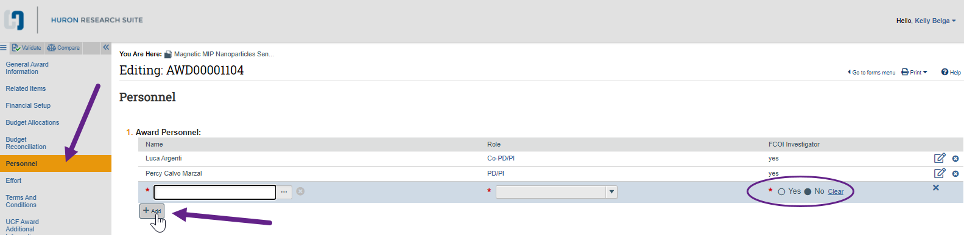
Grants v10.0 Upgrade Research Community- New FCOI Investigator
New Award Personnel Page
Notes:
In Awards, Grants 10.0 separated the Personnel Effort Award Smartform page into two separate pages. The Effort Award SmartForm page, which is the same as the current Personnel Effort Page that you are familiar with.
And the new “Personnel” Award SmartForm page. This page was separated out in preparation for integration with the upcoming HRS COI module and captures whether award personnel are FCOI investigators (or are responsible for Design, Conduct or Reporting activities for the research being conducted). This page will be part of the Award SmartForm pages that Colleges/Department Admins fill out as part of the award creation process.
The names displayed on this page and the yes/no indicator as to if the person is an FCOI investigator come from the new FCOI information entered on the proposal from which the award was created in the Add Personnel section mentioned in the previous slides.
Personnel on this page can be deleted if they are not going to be associated with the award or added if they were not initially identified on the proposal.
Only personnel who are considered FCOI Investigators (will have DCR responsibilities), should be added to the new Personnel page an award.
The FCOI Investigator answer can also be edited for users on this page.
If the College/Department Admin has determined that a new FCOI investigator needs to be added to the award, they follow the same process used today during proposal creation to work with the PI to gather names and signatures for new personnel with RCD responsibilities.

Slide 35
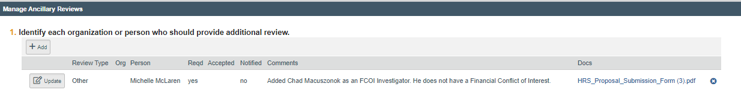
Grants v10.0 Upgrade Research Community- New FCOI Investigator
Adding to a New Award
If one or more FCOI Investigators need to be added to an award, an Ancillary Review of type “Other” ” will need to be created to COI (Michelle McLaren) with a message in the comments about the review needed (i.e., Added John Smith as an FCOI investigator to the award. John Smith does not have a financial conflict of interest.) and the certification document with required signature used in the proposal process today will need to be attached.
Note: Providing the information about the type of reviews required (DCR and/or Financial Conflict of Interest) will speed up how quickly the review can be completed by the COI Team.
Note: This would be a required review and COI has indicated that the award modification should not be activated until this review by COI is compete.
Notes:
If one or more FCOI Investigators need to be added to an award, an Ancillary Review of type “Other” ” to COI (Michelle McLaren) with a message in the comments about the review needed (i.e., Added John Smith as an FCOI investigator to the award. John Smith does not have a financial conflict of interest.) will need to be created and include the certification document with required signature used in the proposal process todIf one or more FCOI Investigators need to be added to an award, an Ancillary Review of type “Other” ” will need to be created to COI (Michelle McLaren) with a message in the comments about the review needed (i.e., Added John Smith as an FCOI investigator to the award. John Smith does not have a financial conflict of interest.) and the certification document with required signature used in the proposal process today will need to be attached.
Note: Providing the information about the type of reviews required in the comments (DCR and/or Financial Conflict of Interest) will speed up how quickly the review can be completed by the COI Team.
Note: This is a required review and COI has indicated that the award activation should not be activated until this review by COI is compete.
The College/dept admin would follow current procedure to fill out the rest of the SmartForm pages for which they are responsible and notify the award manager that they have finished.

Slide 36
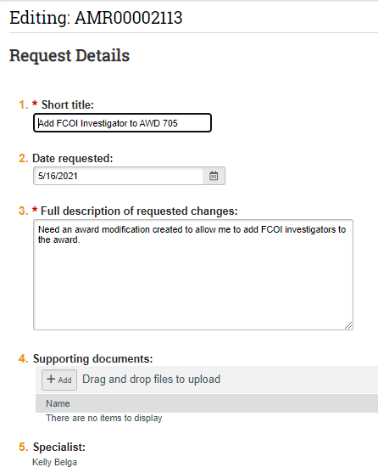
Grants v10.0 Upgrade Research Community- New FCOI Investigator
Adding to an Existing Award
Adding FCOI Investigators to an Active award
Indicate that you are adding FCOI Investigators so that the Award Manager can create the correct type of award mod
Notes:
If a College/Department Admin determines that one or more new FCOI Investigators needs to be added to an existing award, they would open an AMR indicating that the want to add these Investigators to the award.

Slide 37
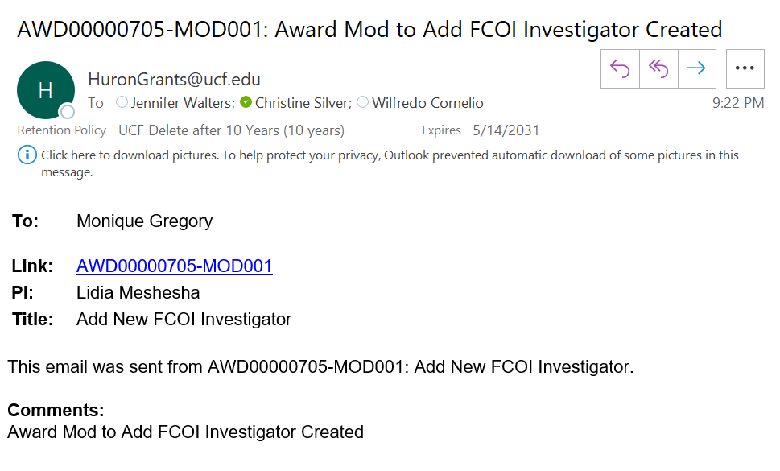
Grants v10.0 Upgrade Research Community- New FCOI Investigator
Adding to an Existing Award
Once the award mod is created, the Award Manager uses the “Send Email” activity to let the College/Department Admin know that the mod has been created.
The College/Department Admin will fill out the award mod using the same process used today during proposal creation to work with the PI to gather names and signatures for new persons with RCD responsibilities.
Notes:
Once the award mod is created, the Award Manager uses the “Send Email” activity to let the College/Department Admin know that the mod has been created.
The College/Department Admin will fill out the award mod using the same process used today during proposal creation to work with the PI to gather names and signatures for new persons with RCD responsibilities.

Slide 38
Grants v10.0 Upgrade Research Community- New FCOI Investigator
Adding to an Existing Award
If one or more FCOI Investigators need to be added to an award, an Ancillary Review of type “Other” ” will need to be created to COI (Michelle McLaren) with a message in the comments about the review needed (i.e., Added John Smith as an FCOI investigator to the award. John Smith does not have a financial conflict of interest.) and the certification document with required signature used in the proposal process today will need to be attached.
Note: Providing the information about the type of reviews required (DCR and/or Financial Conflict of Interest) will speed up how quickly the review can be completed by the COI Team.
Note: This would be a required review and COI has indicated that the award modification should not be activated until this review by COI is compete.
Notes:
Again, when adding FCOI Investigators to an award, an ancillary review of type “other” will need to be created to COI (Michelle McLaren) with a message in the comments about the review needed (i.e., Added John Smith as an FCOI investigator to the award) and the certification document with required signature used in the proposal process today will need to be attached.

Slide 39
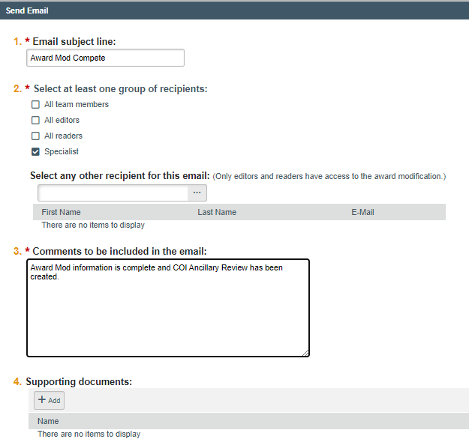
Grants v10.0 Upgrade Research Community- New FCOI Investigator
Adding to an Existing Award
Once the award mod is complete, the College/Department Admin uses the “Send Email” activity to let the Award Manager know that the mod has been completed.
Notes:
Once the award mod is complete, the College/Department Admin uses the “Send Email” activity to let the Award Manager know that the mod has been completed.
(For Turnaround times, refer those questions to Mary Davis and Michelle McLaren)

Slide 40
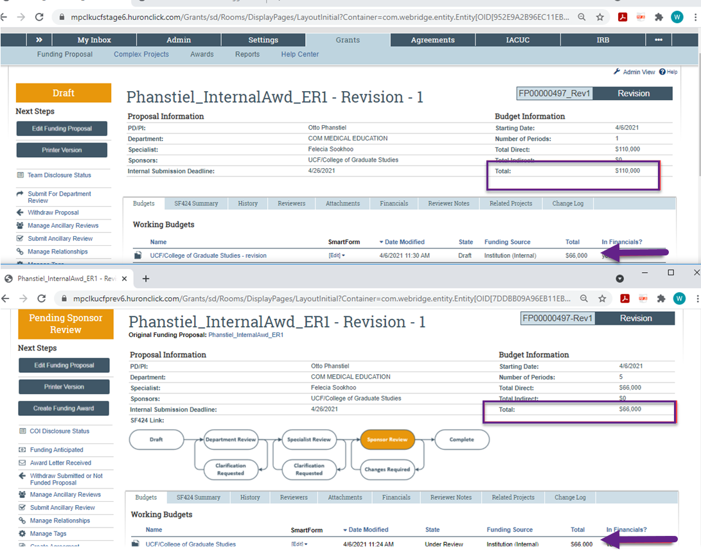
Grants v10.0 Upgrade Research Community- Follow-On Proposals
Revision Proposals
On Revision proposals, the "Total" budget amount displayed on the Revision Proposal Workspace only contains dollars from the Revision Budget. In prior versions, the Revision Budget total was added to the overall FP Budget total.
Notes:
We also wanted to point out this change in revision proposals where the total budget amount displayed on the revision proposal workspace only contains dollars from the revision budget in 10.0, unlike our current 9.0 that added the revision budget to the overall Funding proposal budget total.

Slide 41
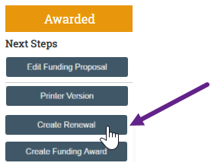
Grants v10.0 Upgrade Research Community- Follow-On Proposals
Renewal Proposals
Admin Contacts and Proposal Editors can now create Renewal Proposals
Notes:
Admin Contacts and Proposal Editors can now create Renewal Proposals

Slide 42
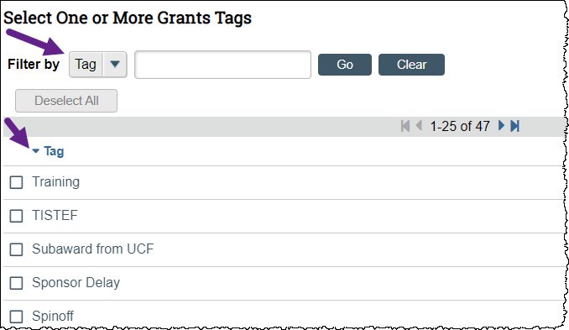
Grants v10.0 Upgrade Research Community- Tags
You can now filter tags and sort the list alphabetically
Notes:
Another new feature provided in the upgrade is the ability to search or sort and filter the Tags list in the first question of the Manage Tags Activity.
This has been something of a pain point when adding new tags as the lists were not automatically alphabetized and can get long, making searching for existing tags cumbersome.
You can search for specific tags, filter the list or sort in ascending or descending alphabetical order.

Slide 43
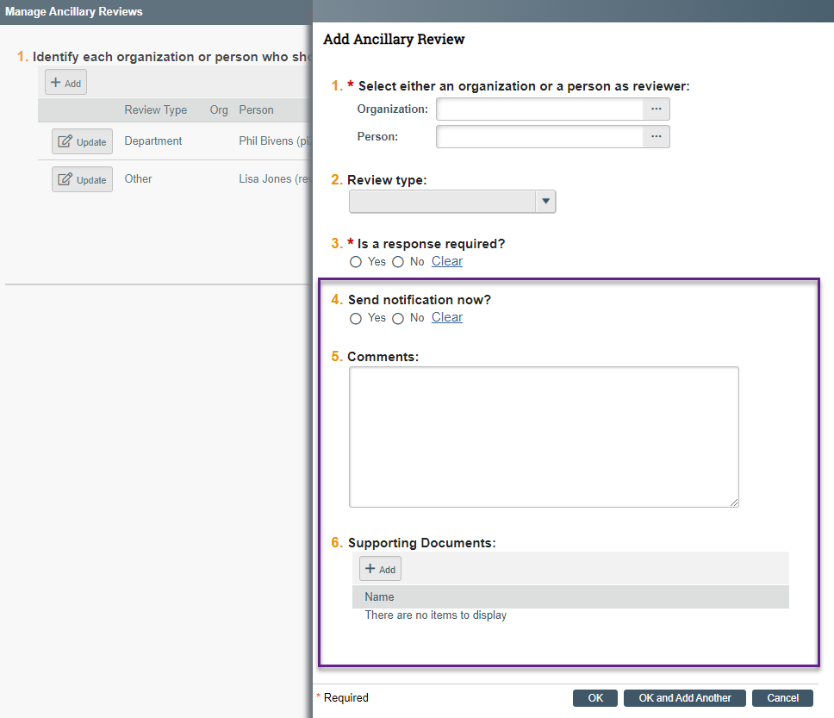
Grants v10.0 Upgrade Research Community- Ancillary Reviews
Comments & Documents included in email notifications
Notes:
For Ancillary Review Changes, I mentioned that automatic notifications will now be sent on proposal ancillary reviews and will include comments and documents, if provided. This screen shows where you capture that information that is displayed in the notification.

Slide 44
Grants v10.0 Upgrade Research Community- Known Issue
An update in 9.1 is causing Awards with outstanding deliverables (regardless of the due date) to display in the Inboxes of users on those deliverables (both the Responsible Party and the Additional Staff).
Workaround: The workaround is to sort and/or filter out Awards in the Active status on the Dashboard to view a list of records that require action.
Please refer to the Research Community reference guide for instructions on how to exclude key words in searches.
Huron clients, including UCF, provided feedback that Huron should consider revising this update. The update will be reverted in the Grants 10.0.1 hotfix planned for June 2021.

Slide 45
Grants v10.0 Upgrade Training- Bug Fixes
Pre-Award Issues
Proposals – Today, when a Funding Proposal is copied, a link to the new copy appears in the History. In 10.0, the history tab of the new copy will include a link to the proposal from which it was copied.
Proposals - When the user updates the direct sponsor on a Funding Proposal, the budget maintains the non-standard F&A cost base rate, if selected.
Proposals - When a user copies a Funding Proposal that includes a Budget that has been withdrawn, the Proposal is copied and does not include the withdrawn Budget in the copy. Fix also applies to withdrawn Subaward Budgets.
Proposals – FPs in the “Award Notification Received” and “Awarded” states no longer display in your inbox
Notes:
.

Slide 46
Grants v10.0 Upgrade Training- Bug Fixes
Awards – New user added to an Award deliverable as additional staff will have read access to the award. When a deliverable is marked as complete, the additional staff will still have read access to the award.
Award Mods – Specialists and the Research Community should now be able to create revisions and renewals for funding Proposals, regardless of which role they fill in this project.
Post-Award Issues

Slide 47
Questions?
Notes:
If you think of any other questions or concerns, please do not hesitate to reach out to me, Wil, Jen or the GRIT service desk. We’re happy to help and make this transition to HRS 10.0 as smooth as possible.

